Slide 1
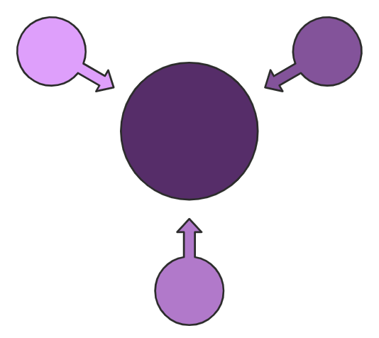


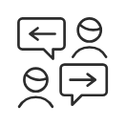

App for
Converting
Sign Language to Written Text
project
Supervisor :
DR.BASSM MOHAMED
ENG : Esraa Mohsen

Slide 2
Menna Tallah Khaled
Our team Members
Abdelrahman Ahmed
Mena Maged
Yusra Abdel Zaher
Abdelrahman Ali
Sabry Salah Elden
Marwa Salem

Slide 3
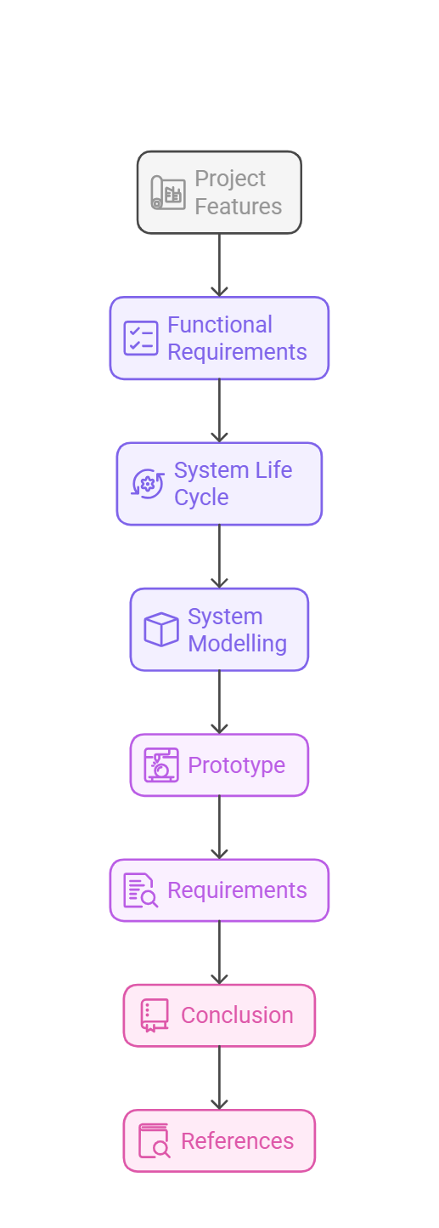
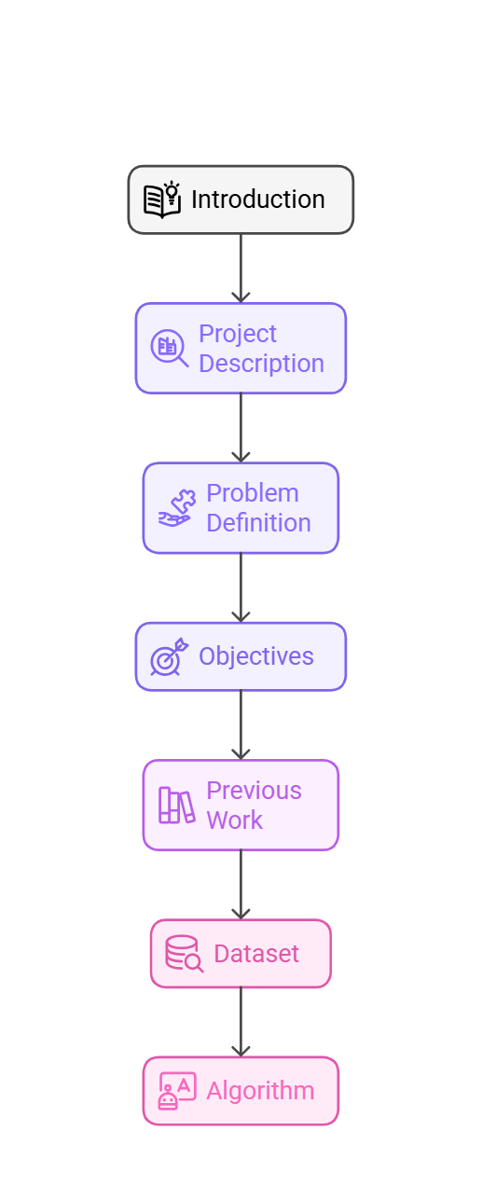

Content

Slide 4

Abstract
This project aims to develop an intelligent application that facilitates communication for the deaf and mute by converting sign language into written text . The app leverages artificial intelligence and deep learning techniques to process hand gestures and recognize patterns, enabling users to express their thoughts clearly without the need for an interpreter.
The application features a user-friendly interface that supports multiple languages, along with the ability to customize the sign language dictionary to meet different user needs. Additionally, it offers an interactive learning feature to help non-sign language speakers understand and engage with sign language more effectively.
This project contributes to the social integration of the deaf and mute community by enabling seamless communication with individuals who do not understand sign language, ultimately enhancing their opportunities in education, employment, and social interaction.

Slide 5
Introduction
Human communication is one of the most important means of expression and social interaction. However, for individuals who
use sign language to communicate, they may face difficulties interacting with others who do not understand this language.
Therefore, a mobile application project that converts sign language into written text is a significant step towards
facilitating this communication and providing innovative technological solutions to support this community.

Slide 6
Project description:
The deaf and mute face challenges in communicating with others, leading to psychological issues and social isolation. They need solutions to help them express their needs and integrate better into society
So This project proposal outlines the development of a mobile application that aims to bridge the communication gap between individuals who use sign language and those who do not.

Slide 7
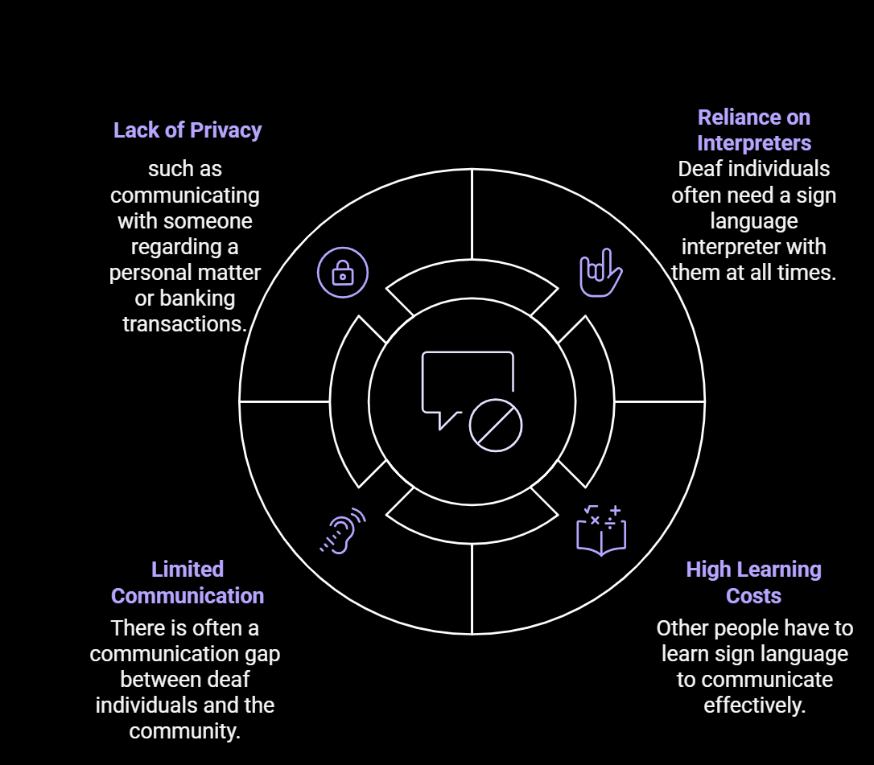
Problem Definition:
The deaf and mute traditionally rely on sign language for communication, but it is often ineffective and not understood by many people. This leads to various Problems, most notably:-

Slide 8
Objectives:
Creating an application App for Converting Sign Language toWritten Text project that achieves the following:-
1. Self-Reliance: The app enables individuals to communicate independently without needing a sign language interpreter at all times.
2. Ease of Communication in Public Spaces: In places like hospitals, banks, or shops, there’s no need for someone to know sign language to understand a deaf individual.
3. Supporting Daily Life and Quick Interactions : The app assists deaf individuals in their daily Interactions, like speaking with service providers, inquiring about products, or having regular conversations.
5. Cost Reduction: Others don’t need to learn sign language to communicate with a deaf person.
4. Support Education: Provide interactive learning modules to help users learn and practice sign language, promoting sign language literacy among both deaf and hearing individuals.
6. It supports the person’s freedom and independence in daily life.

Slide 9
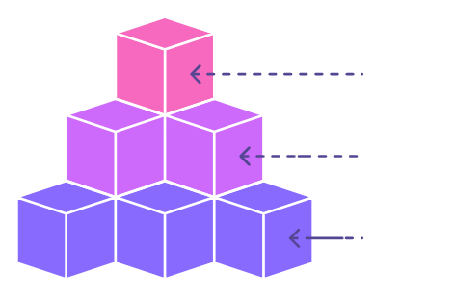
Previous Work
Exploring the latest advancements in sign language translation technology, from specialized hardware to mobile-friendly solutions, to empower seamless communication.

Slide 10
SignAll: Comprehensive Sign Language Translation
Advantages
Disadvantages
1- Uses AI and deep learning to analyze sign language and convert it into written text and spoken words.
1- Requires specialized hardware like multiple cameras, making it unsuitable for regular mobile use.
2- Utilizes multiple cameras for high accuracy in interpreting hand gestures.
2- High cost due to the need for advanced equipment.
3- Sign recognition may be limited by lighting conditions and gesture precision.
3- Supports multiple languages and sign language dialects.

Slide 11
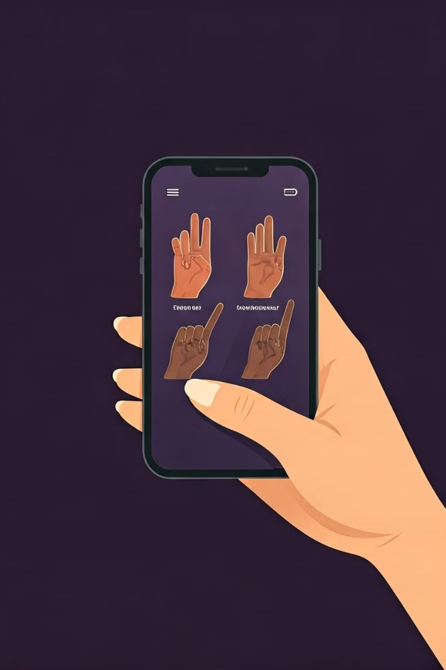
Google's ASL Interpreter: Mobile-Friendly Approach
1
Advantages
1- Relies on machine learning to translate signs into text and speech.
2- No special hardware needed, works easily on mobile devices.
3- Can be integrated into other applications via API.
2
Disadvantages
1-Accuracy is not ideal, especially with fast or complex movements.
2- Limited adaptability to all sign language dialects, relying on a predefined dataset.
3- Still in experimental stages, not fully developed for commercial use or broader scenarios.

Slide 12

HandTalk: Accessible Sign Language Translation
Advantages
Disadvantages
1- Simple user interface, making it easy for regular users to communicate with deaf individuals.
1- Relies on a single dialect of sign language, limiting its usage in communities with different variations.
2- Supports multilingual speech.
2- Accuracy may be lower for more complex gestures.
3- Available on Android and iOS, highly accessible.
3- Requires continuous improvement to expand the dataset and enhance accuracy.

Slide 13
Key Features of the Sign Language Translation App
1
Ease of Use
2
Language Support
A simple and user-friendly interface that allows users to interact with the application without the need for complex training.
The ability to translate gestures into A true integrated language expanding the application's usability.
3
Real-Time Operation
4
Continuous Learning
Instant translation of gestures into text
without delay.
The application uses machine learning to improve its accuracy over time.

Slide 14
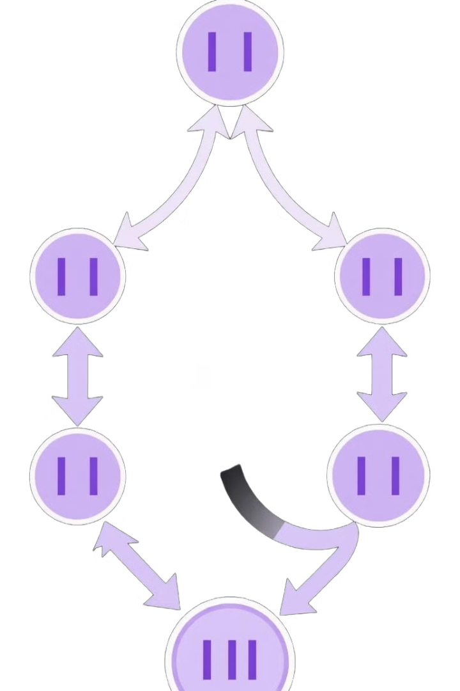
Sign Language Dataset
All-Data
Developed in 2024

Slide 15
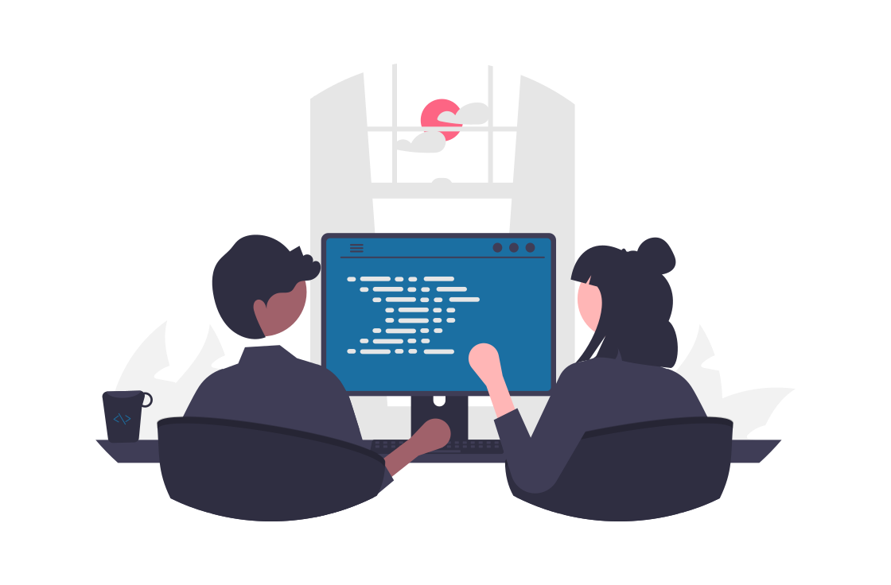
Why This Dataset
The ALL-DATA database is considered an ideal choice for developing an application serving Arabic speakers, as it provides specialized, standardized content that is easy to integrate with technology.

Slide 16
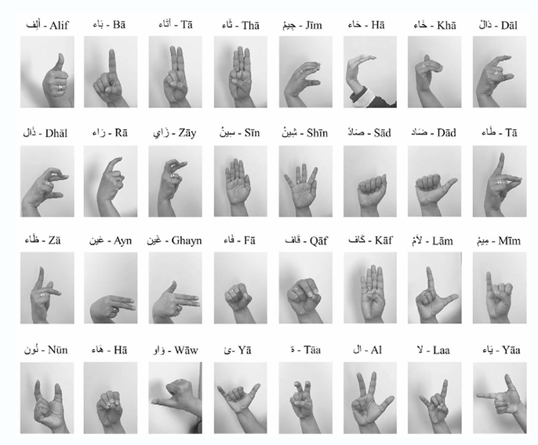
DATA SET DESCRIPTION
Letter Recognition
55,000 images
28 classes (Arabic letters)
Resolution: 224 x 224 pixels
Purpose: Train models like VGG16
for letter-to-text conversion.
Word Recognition
Common Arabic sign words (e.g.,
"Father," "Mother," "Sister," "Egypt,“
"Brother," "How Are You," "I")
NumPy arrays, 30 fps
Purpose: Train models like Conv1D
for sign-to-word conversion

Slide 17
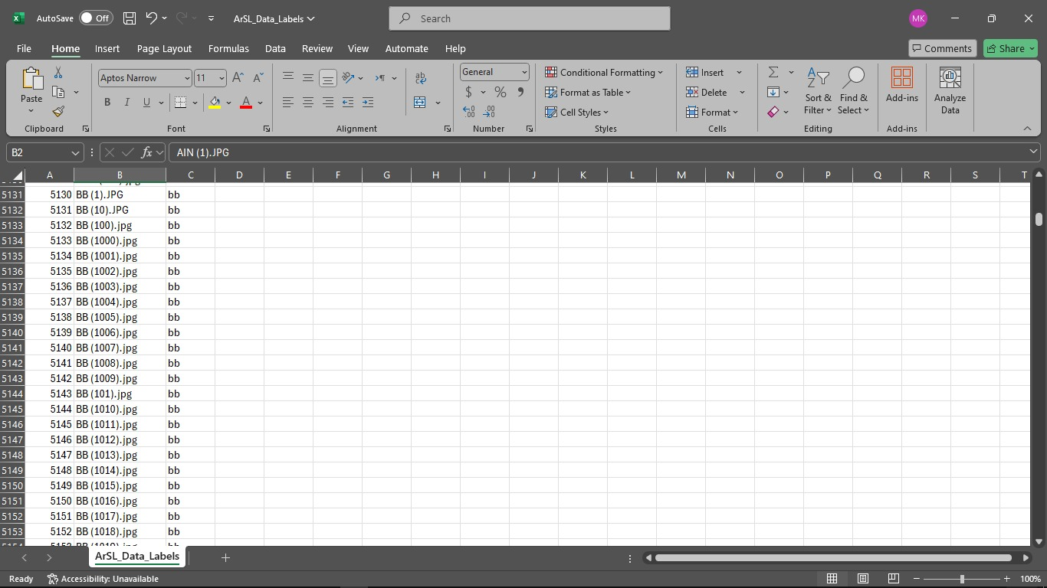
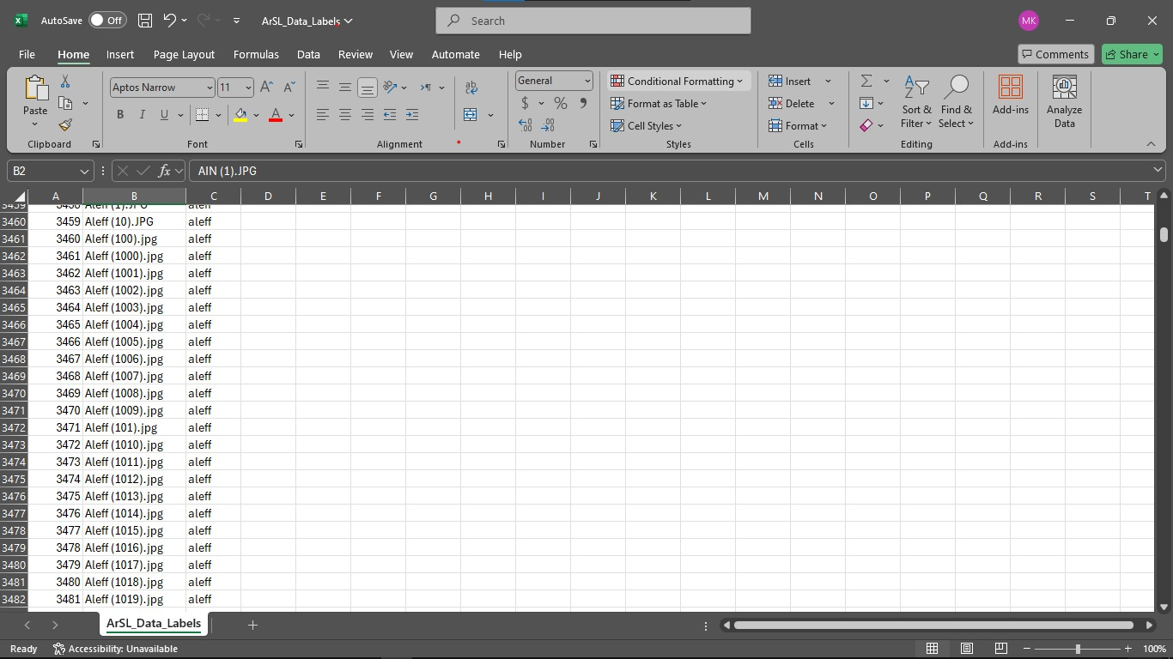

Slide 18

Dataset Components
1
Hand Sign Images
The dataset contains images of users performing hand gestures representing Arabic letters or words.
3
Text Labels
Each image is paired with a text label describing the sign performed in the image
2
Motion Data (Numeric Representation)
Some gestures are stored as numerical data (NumPy arrays) representing hand motion over time instead of videos.

Slide 19
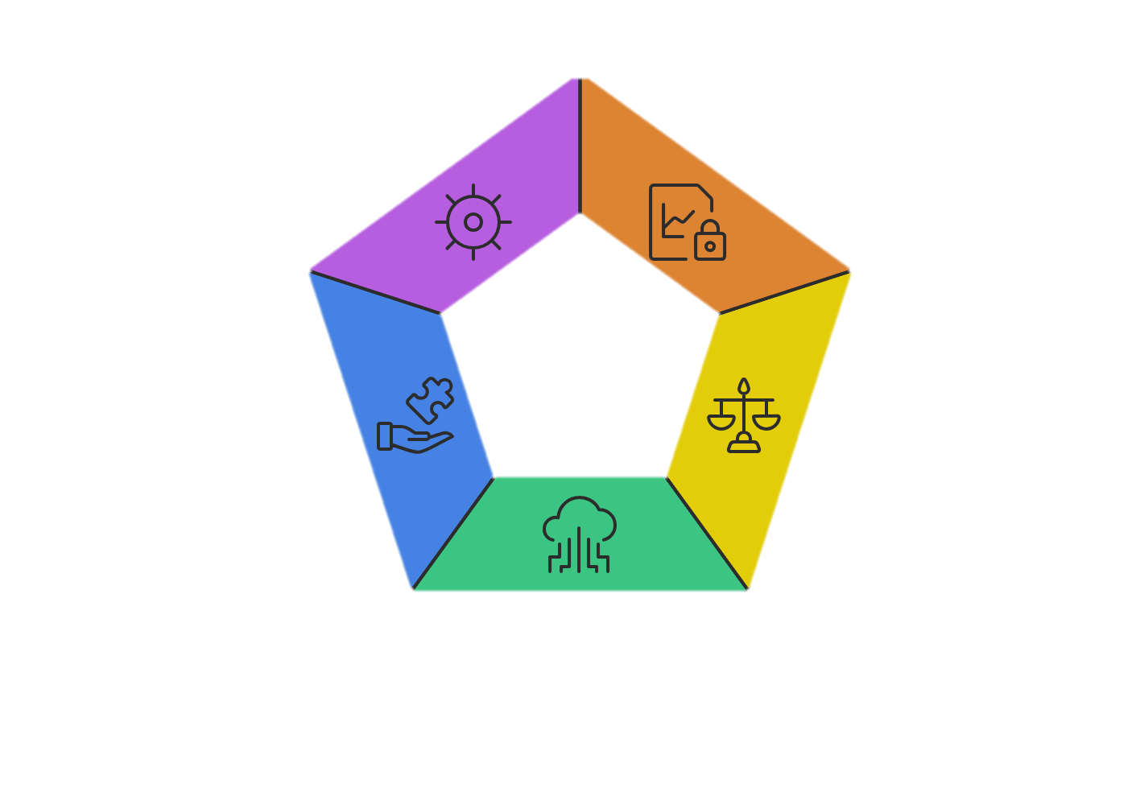
Dataset Challenges
System Integration &
Compatibility
Ensures seamless data
system interactions.
Data Availability
Ensures data is
accessible when
needed.
Data Formatting
Standardizes data for
uniformity and usability
Quality and Reliability
Maintains data accuracy
and trustworthiness.
Dataset Size
Addresses the volume
of data to be managed

Slide 20

Resizing
Brightness
and Contrast
1
2
Resizing The image to 50*50 to speed up the training process
Custom Layer for Brightness and Contrast
Pre-Processing Letter Based
Labeling
the Data
3
Augmentation
4
Custom Layer for Augmentation
Labeling the data ,
Dividing it to Train,
Validate, Test.

Slide 21
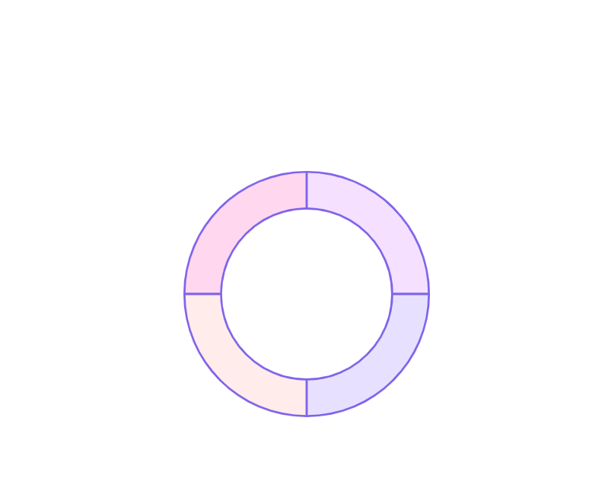
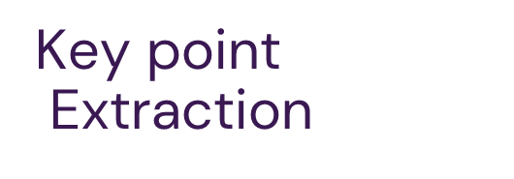

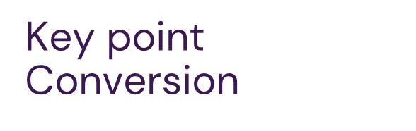
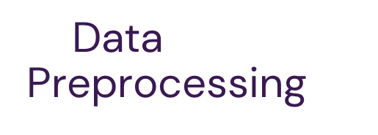


Pre-Processing Wordes Based
Data
Augmentation
Data Augmentation

Slide 22
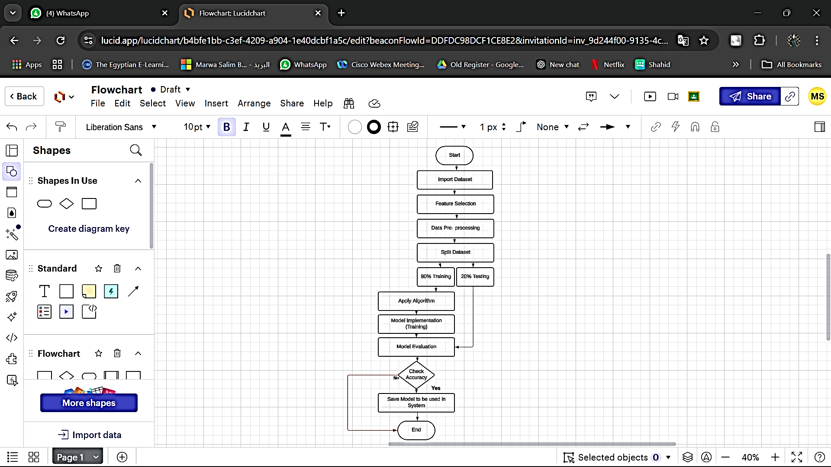
Model-Dataset flowchart

Slide 23
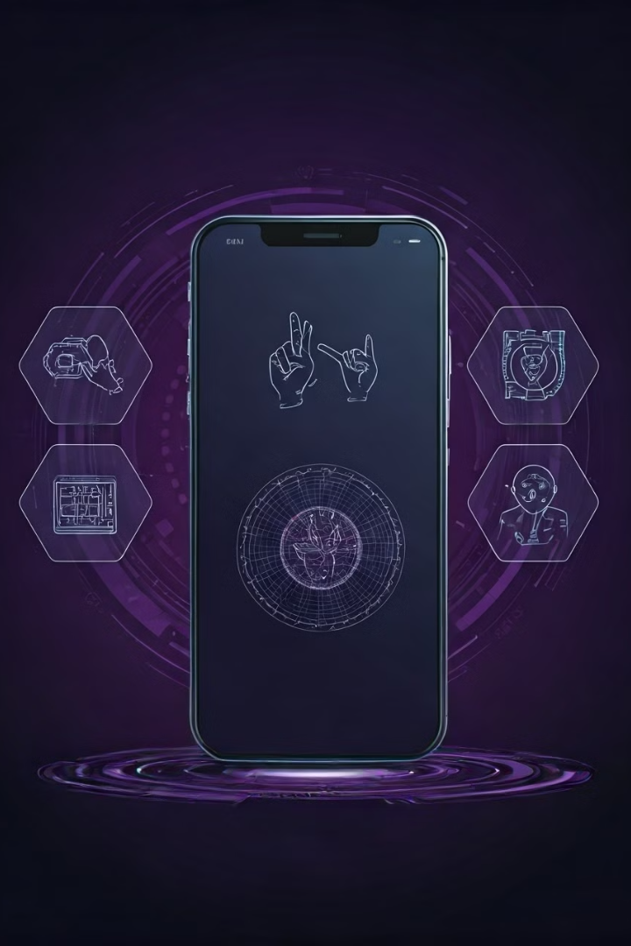
Dataset Usage
1
Training
The dataset is used to train models to recognize signs from video sequences. The model leverages algorithms like Convolutional Neural Networks (CNN) and Recurrent Neural Networks (RNN) to analyze the gestures and translate them into text or speech.
2
Testing
A portion of the dataset is reserved for testing to measure the model’s accuracy in recognizing new signs it hasn’t encountered before.

Slide 24
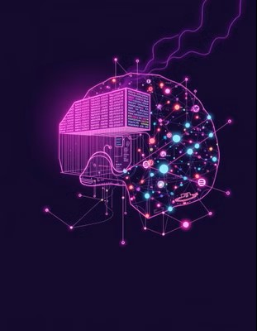
Sign Language
Algorithm
The algorithm is the core component that processes the dataset and converts sign language gestures into written text. It involves several steps, including video processing, feature extraction, gesture recognition, and text-to-speech conversion.

Slide 25
Algorithm Overview
1
Image Processing with Open Pose Algorithm:
Open Pose is a framework that can extract key points from people in images, including hands and fingers.
Using Open Pose, you can identify key points that represent movements in sign language.
2
Gesture Recognition with Convolutional Neural Networks (CNNs):
Convolutional Neural Networks (CNNs) are effective for analyzing images and extracting features. You can use them to identify different hand gestures in sign language.
After processing images with Open Pose, train a CNN model on a dataset of images representing various sign language gestures.
3
RNN or LSTM for Gesture Sequence Processing:
Sign language depends on sequences and context. Long Short-Term Memory (LSTM) or Recurrent Neural Networks (RNNs) can be used to process sequences of images or gestures, ensuring each movement is interpreted correctly within the context.
4
Text-to-Speech (TTS) Conversion:
After translating the gesture to written text, you can use a Text-to-Speech (TTS) algorithm, such as Google TTS or Microsoft Azure Speech API, to convert the text into spoken words.
5
Integrating with a Sign Language Dataset:
Choose a dataset containing videos and images of sign language gestures, such as ASL Dataset or Sign Language MNIST, to train your model. Link this data to the algorithms above.

Slide 26
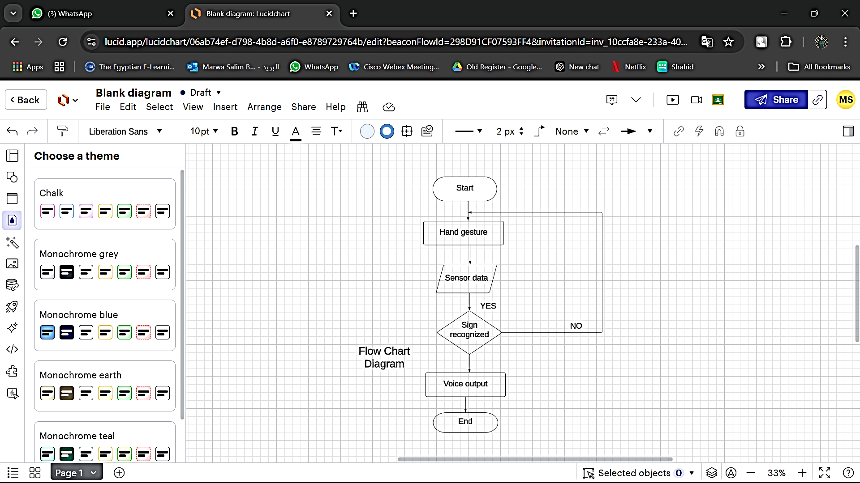

Slide 27
System Life Cycle
1. Planning
4. Development
5. Testing
6.Implementation
7. Maintenance
8. Deployment
2. Analysis
3. Design

Slide 28
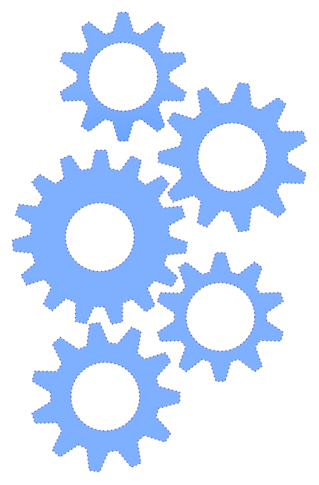
Functional requirement
Record a Video
Login
Upload a Video
Logout
Play the record

Slide 29
Non-Functional Requirements
Reliability
Accessibility
Usability
Flexibility

Slide 30
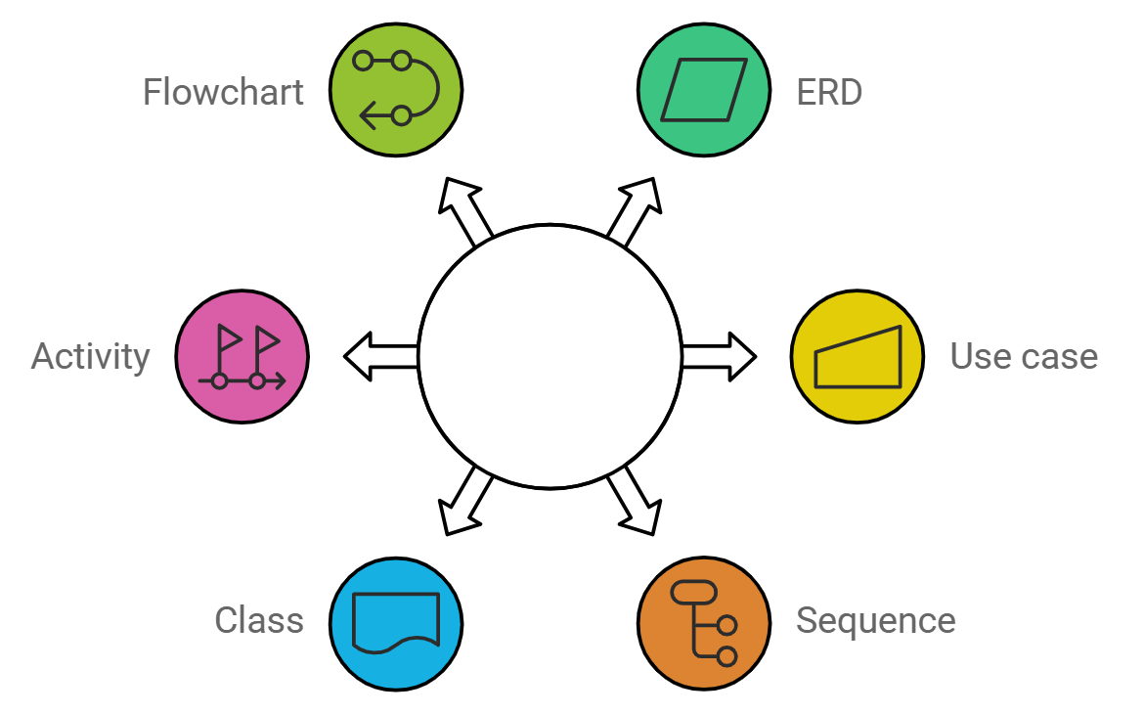
Diagrams

Slide 31
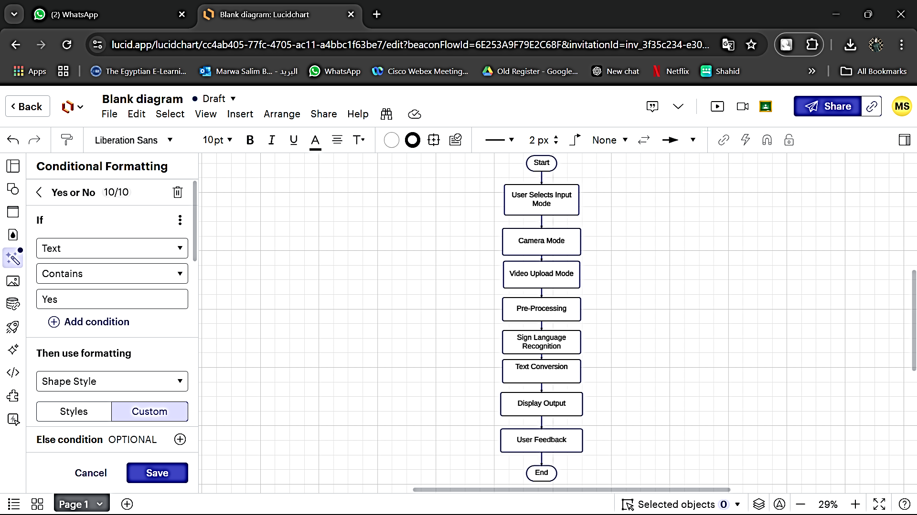
Dataset
Flow Chart

Slide 32
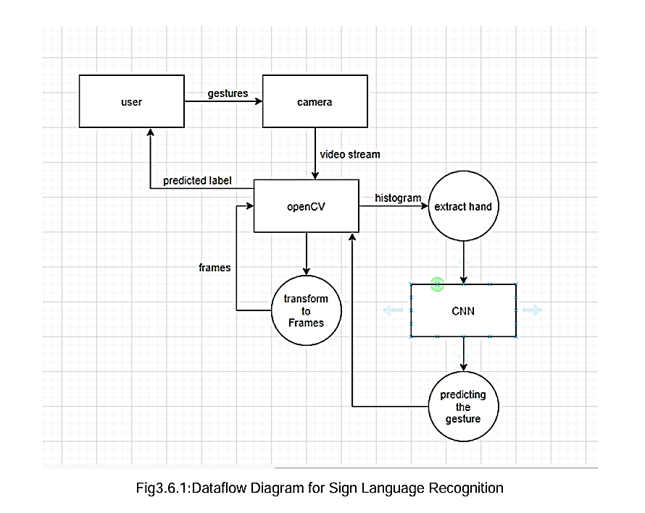

Slide 33
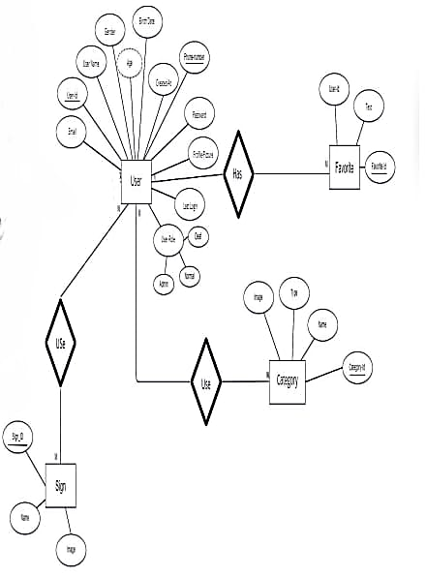
ER-Diagram

Slide 34
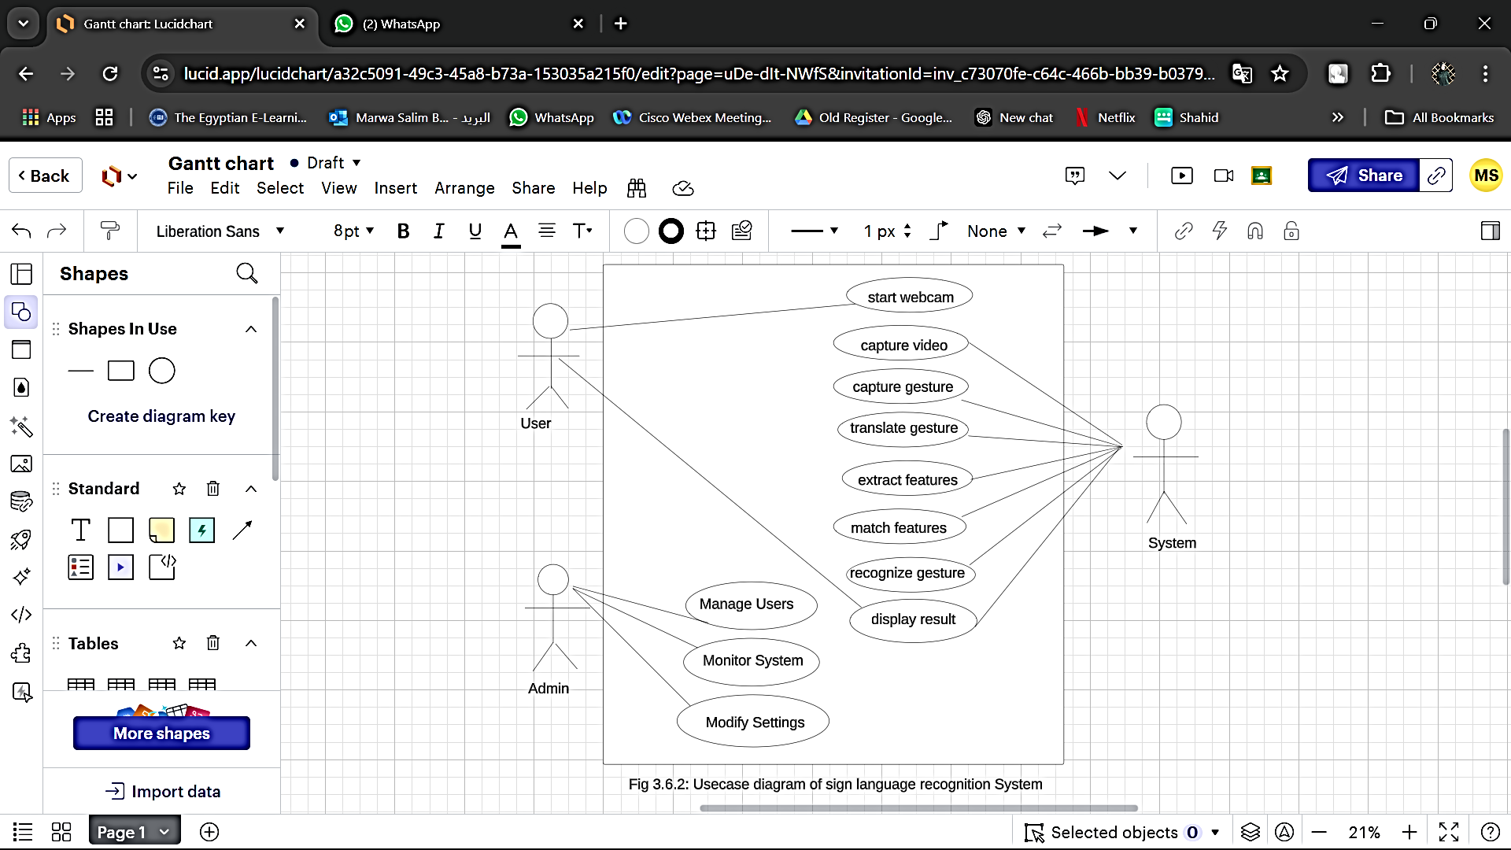

Slide 35
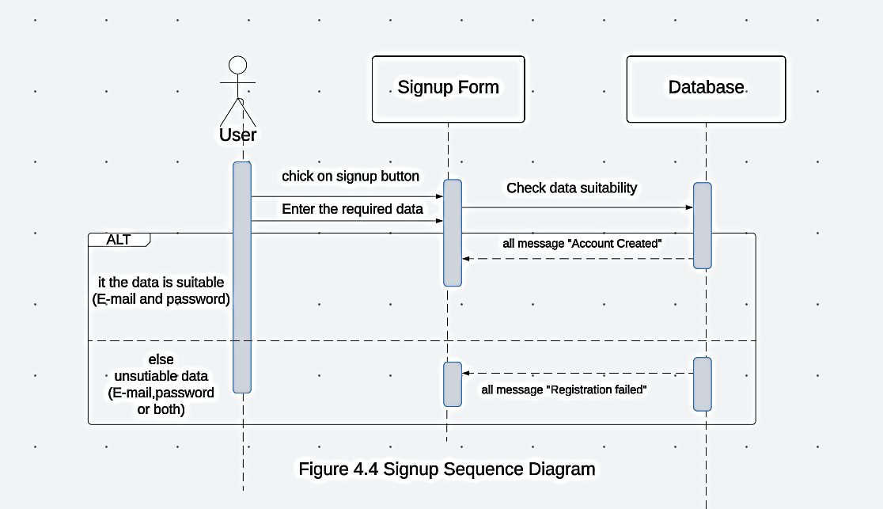

Slide 36
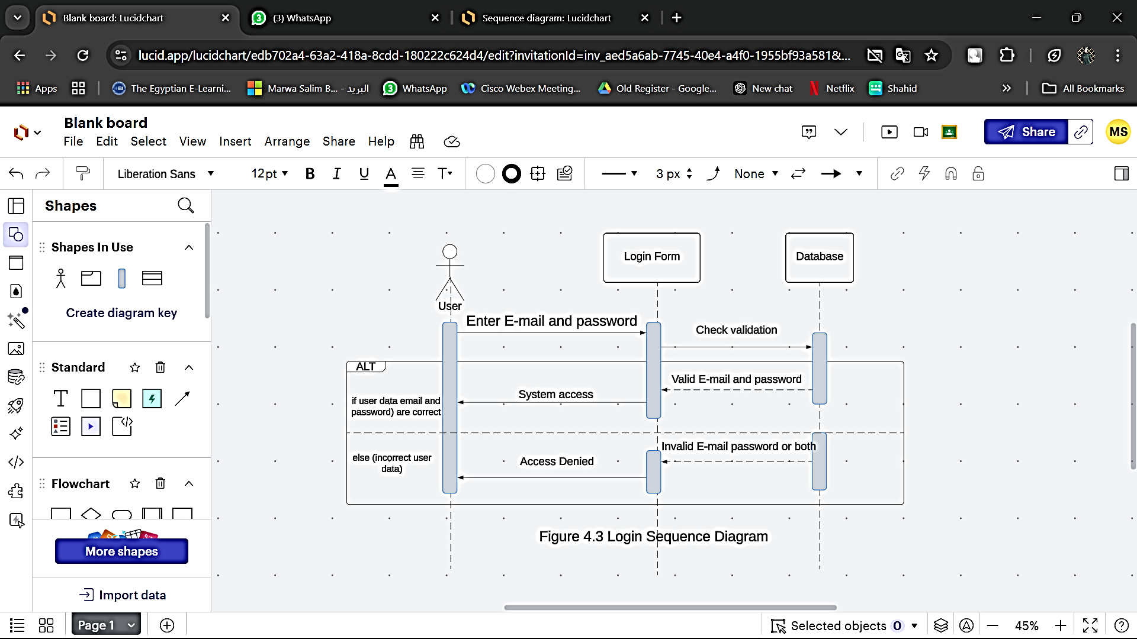

Slide 37
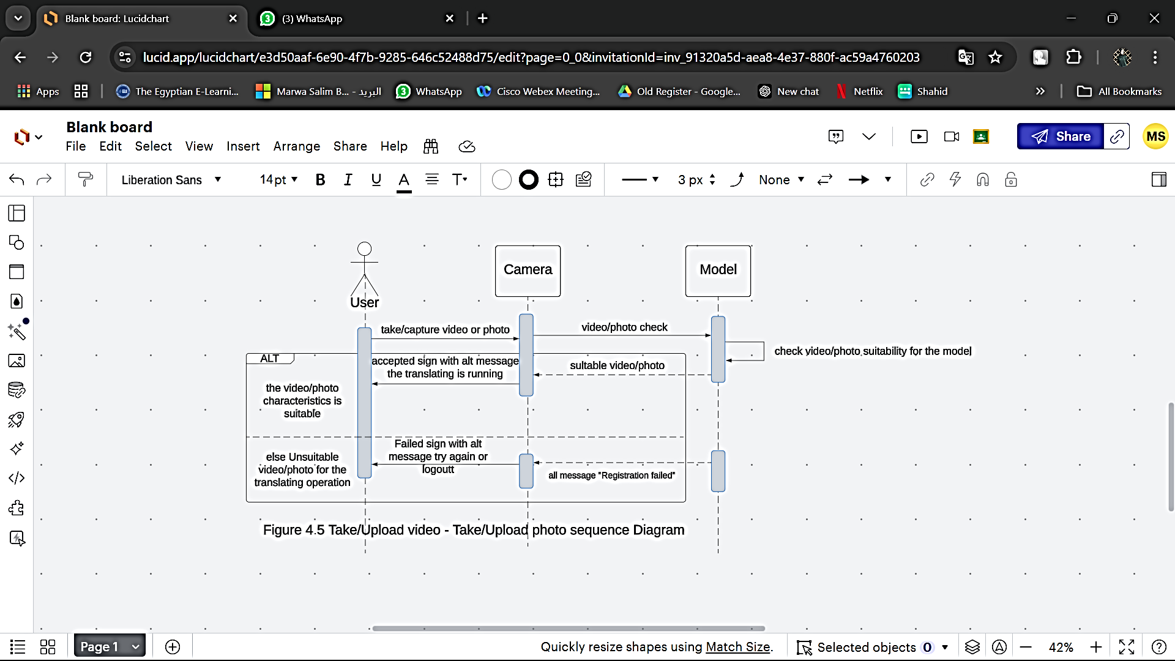

Slide 38
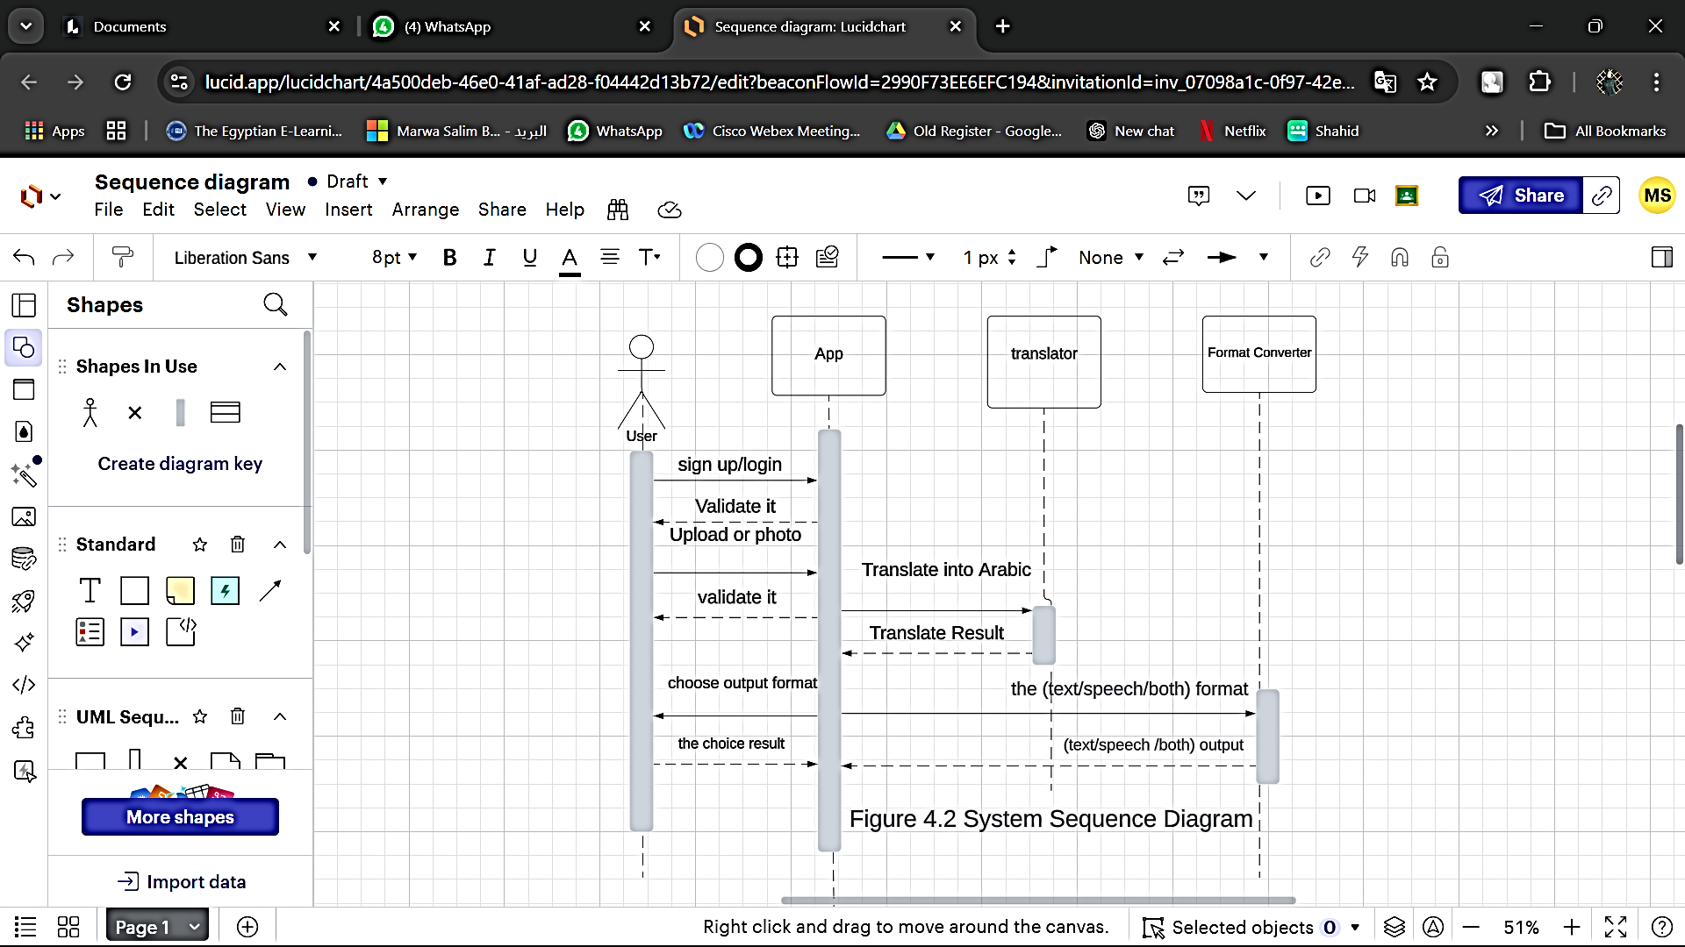

Slide 39
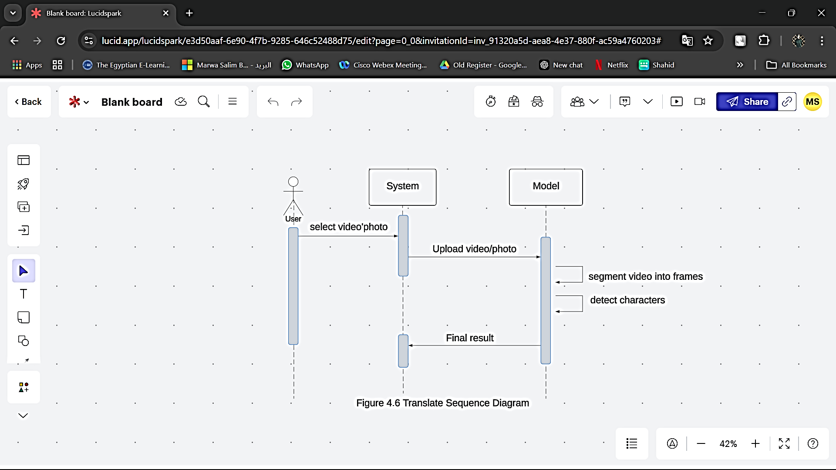

Slide 40
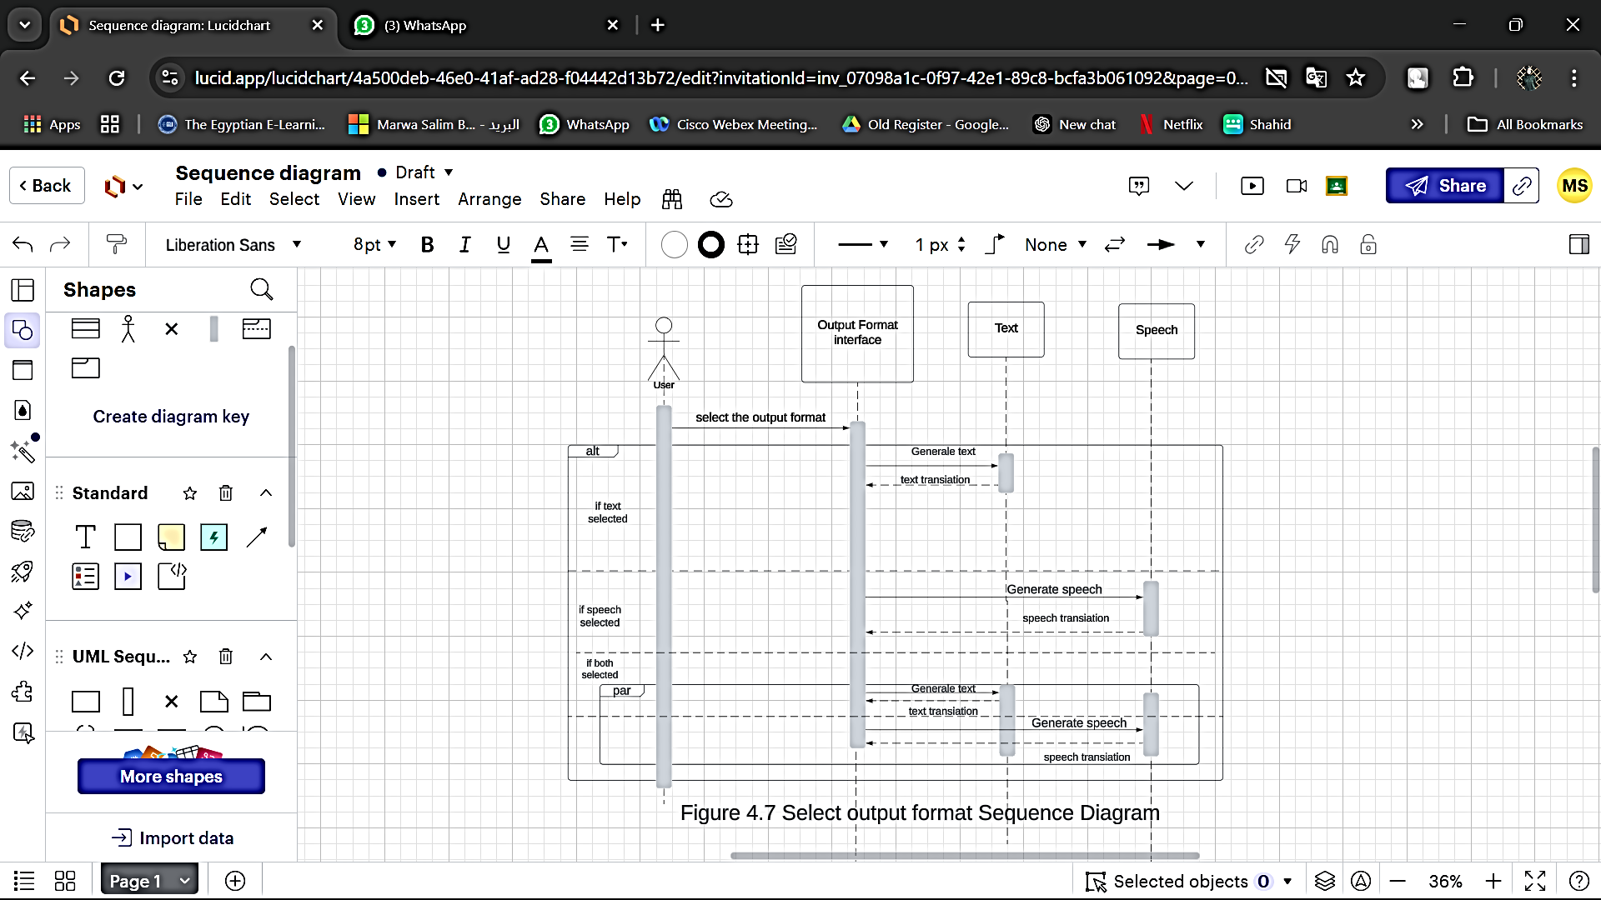

Slide 41
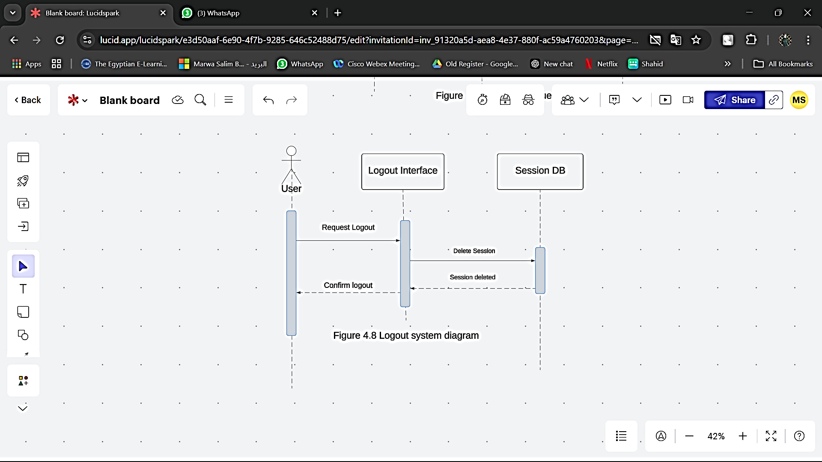

Slide 42
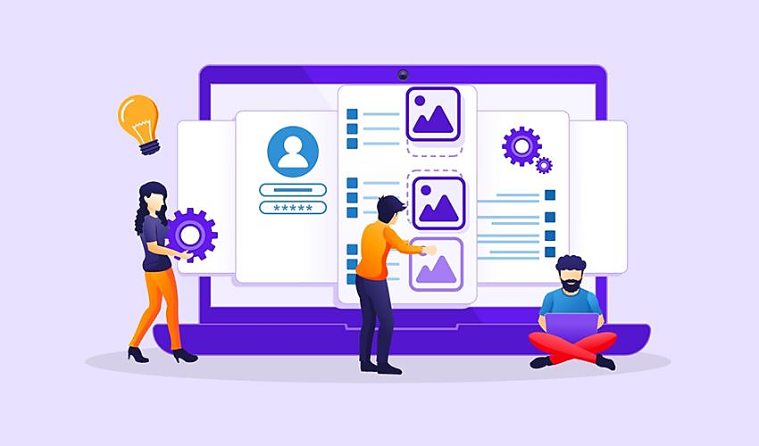
Prototype

Slide 43
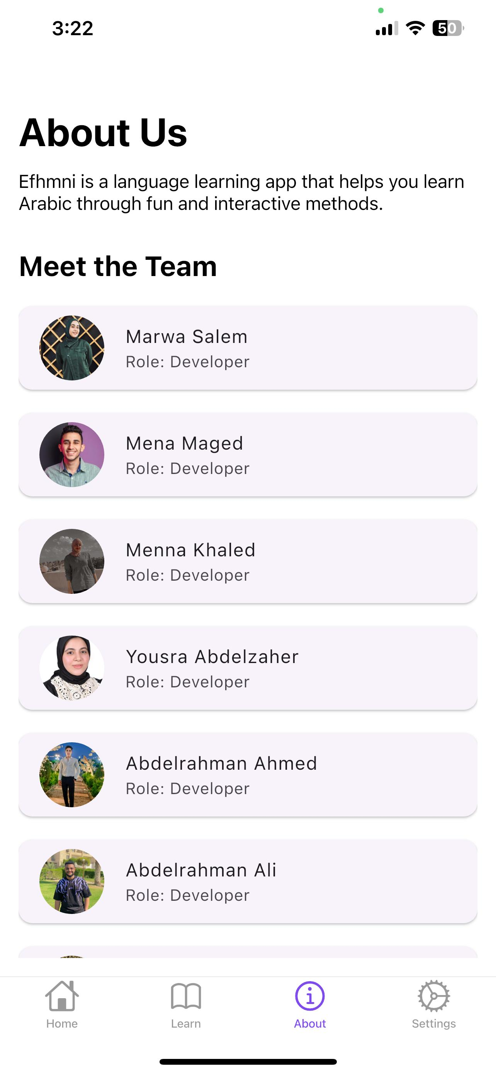
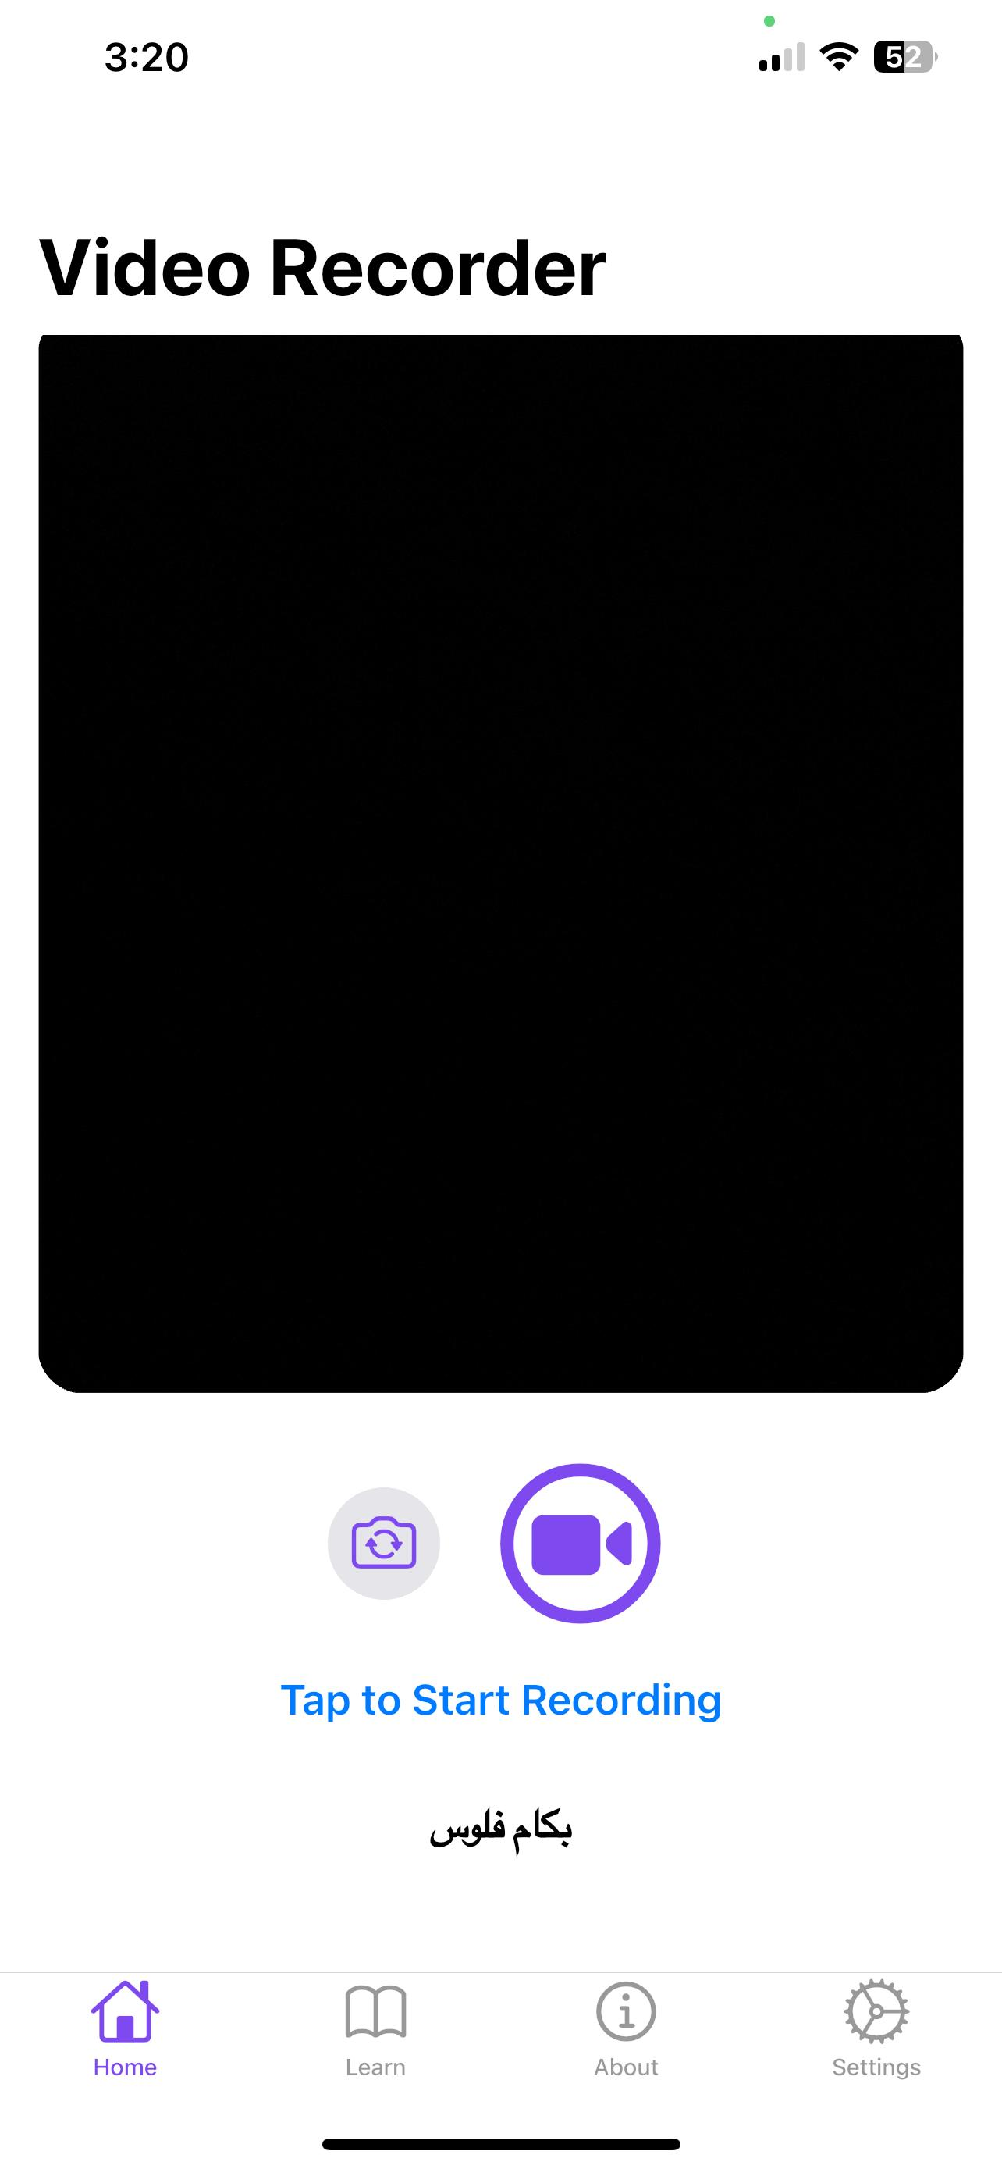
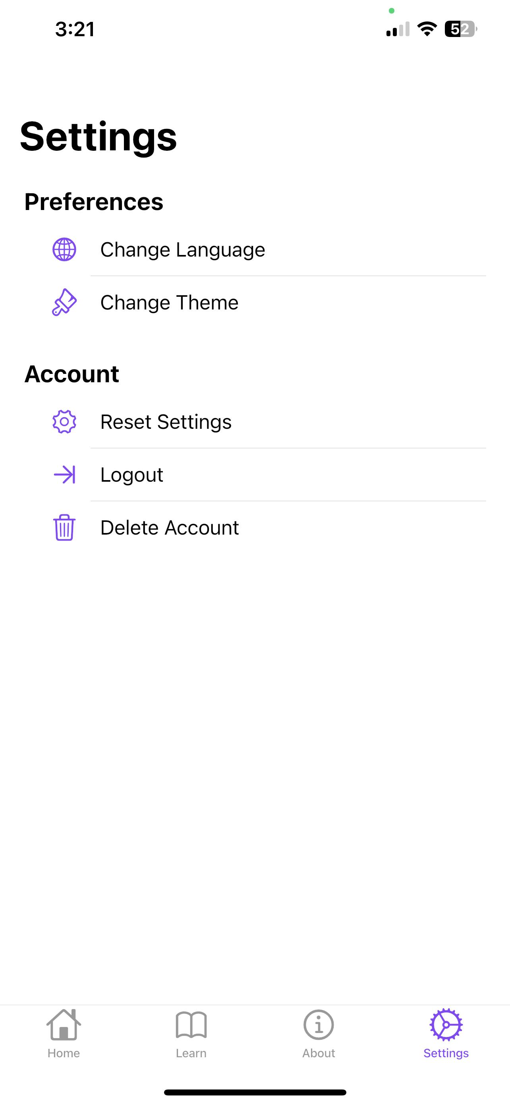

Slide 44
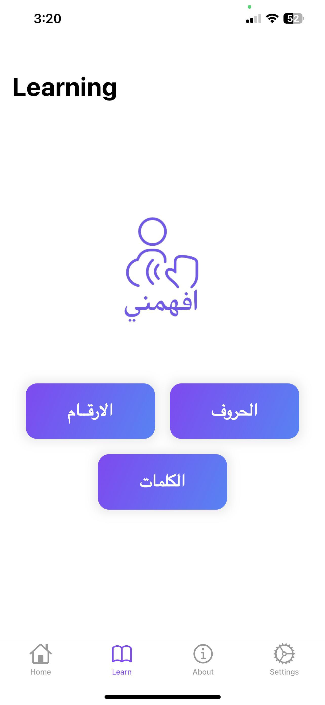
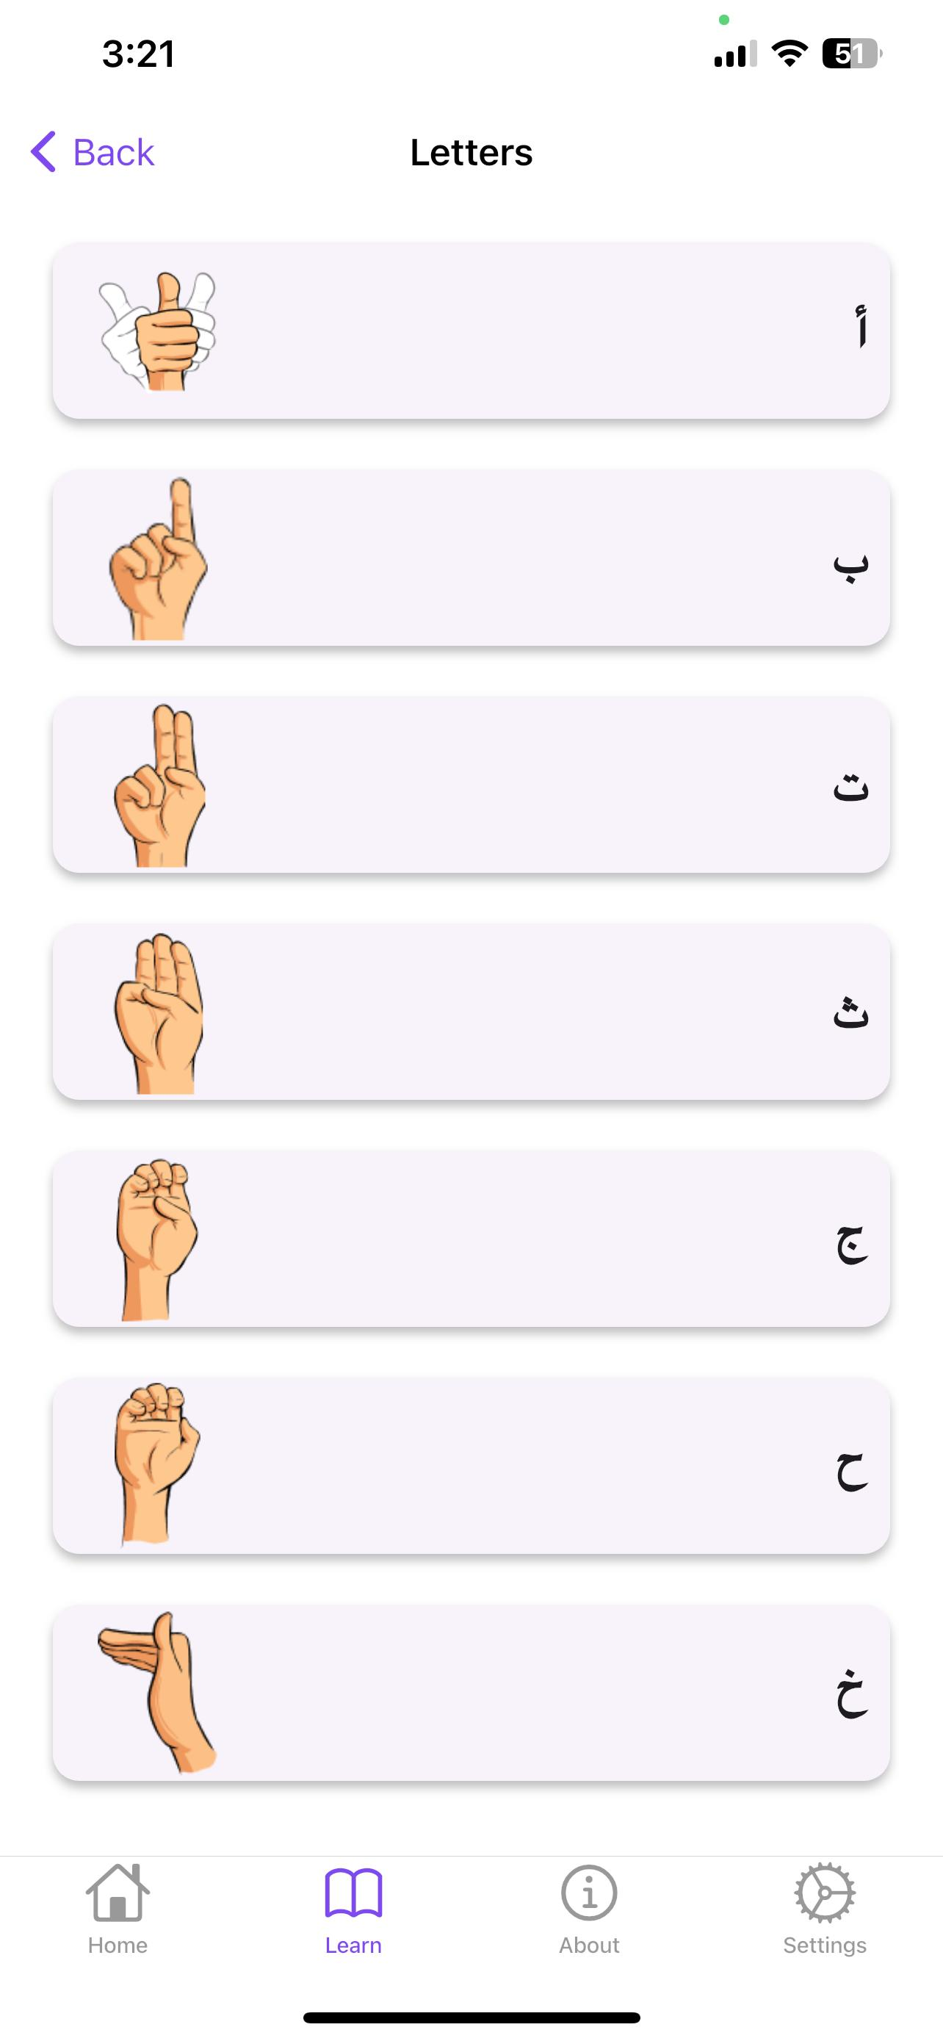
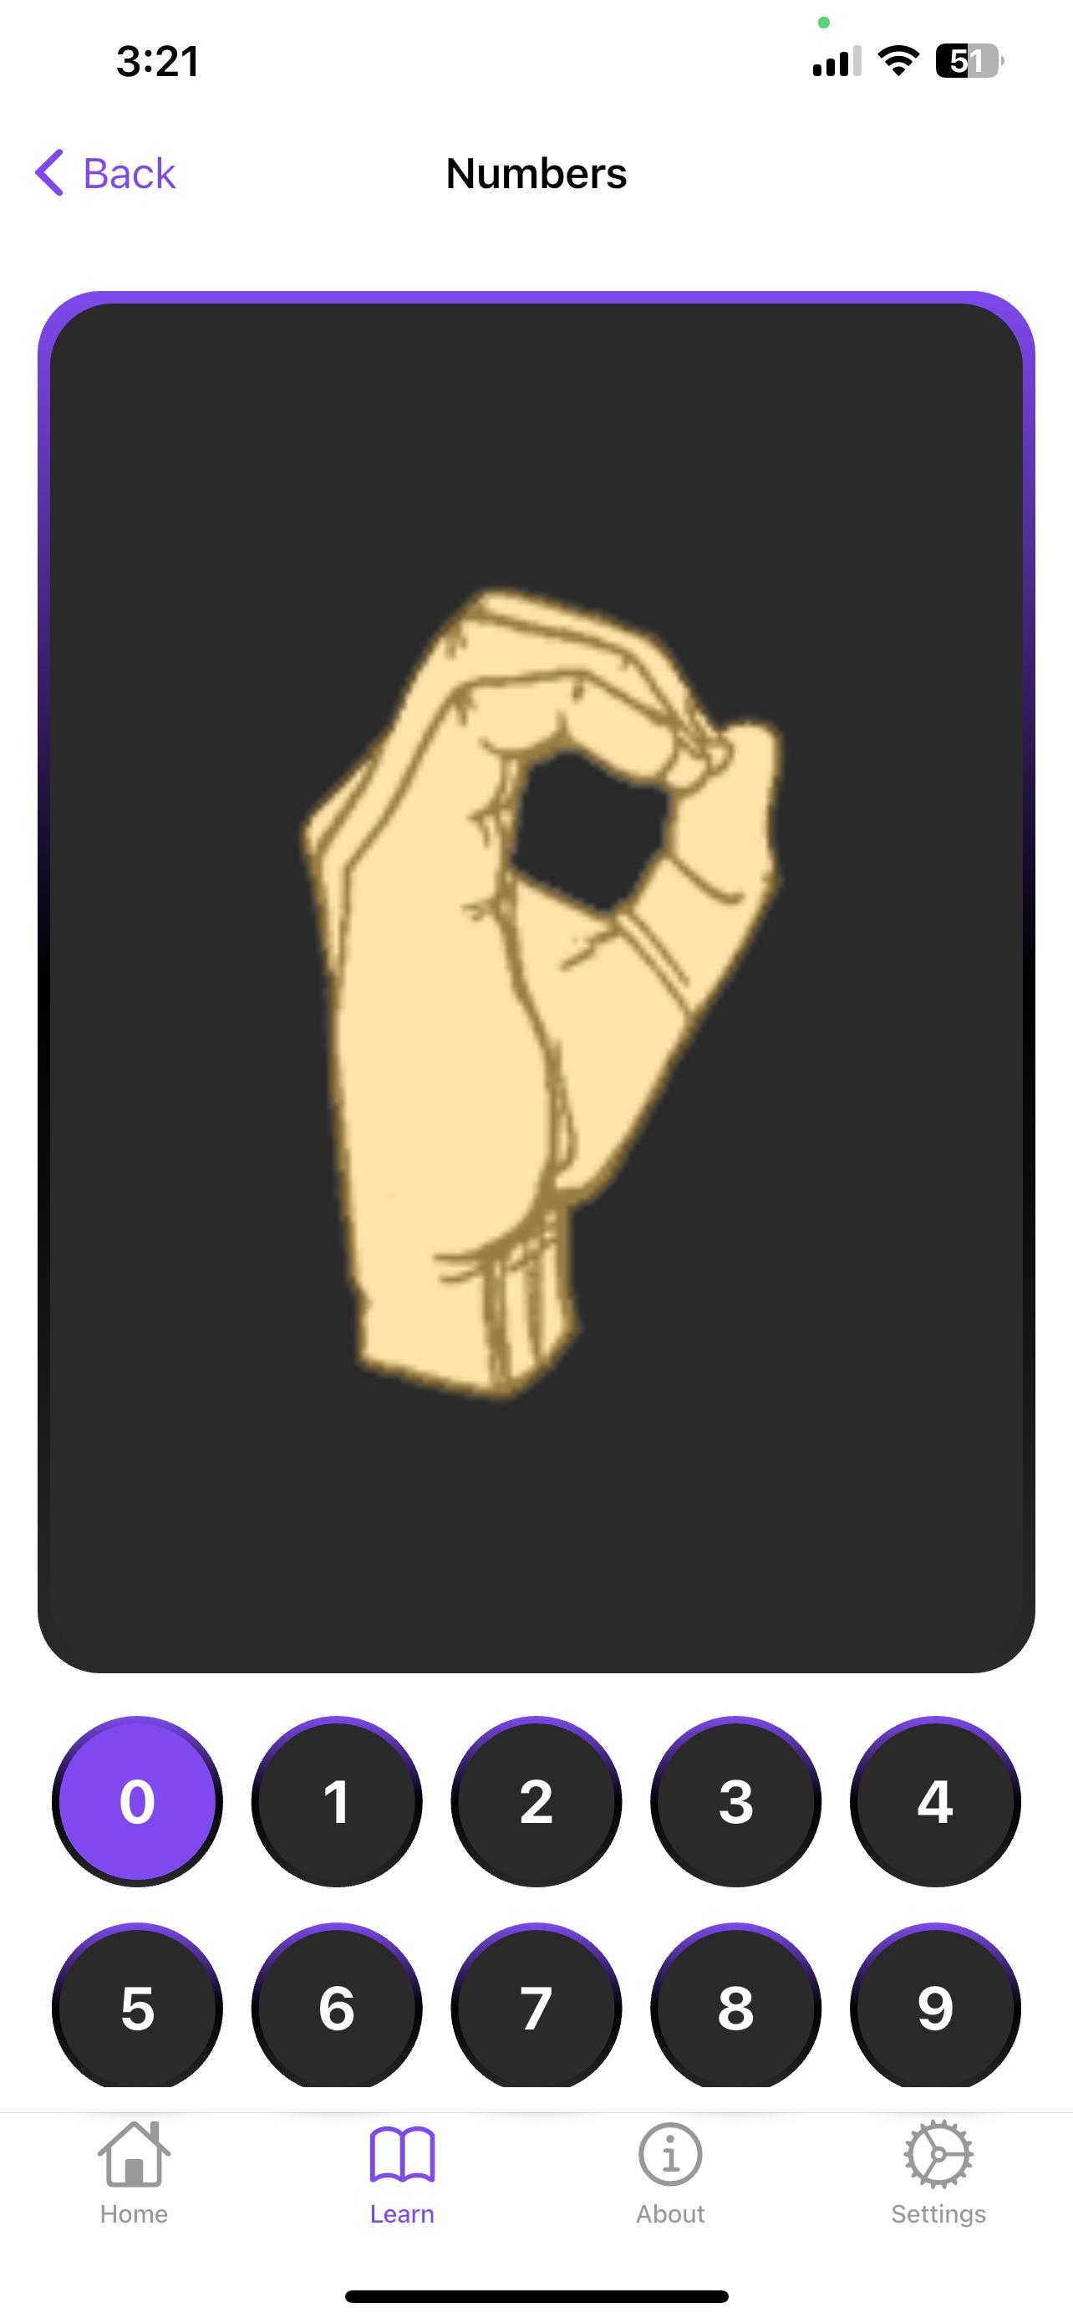
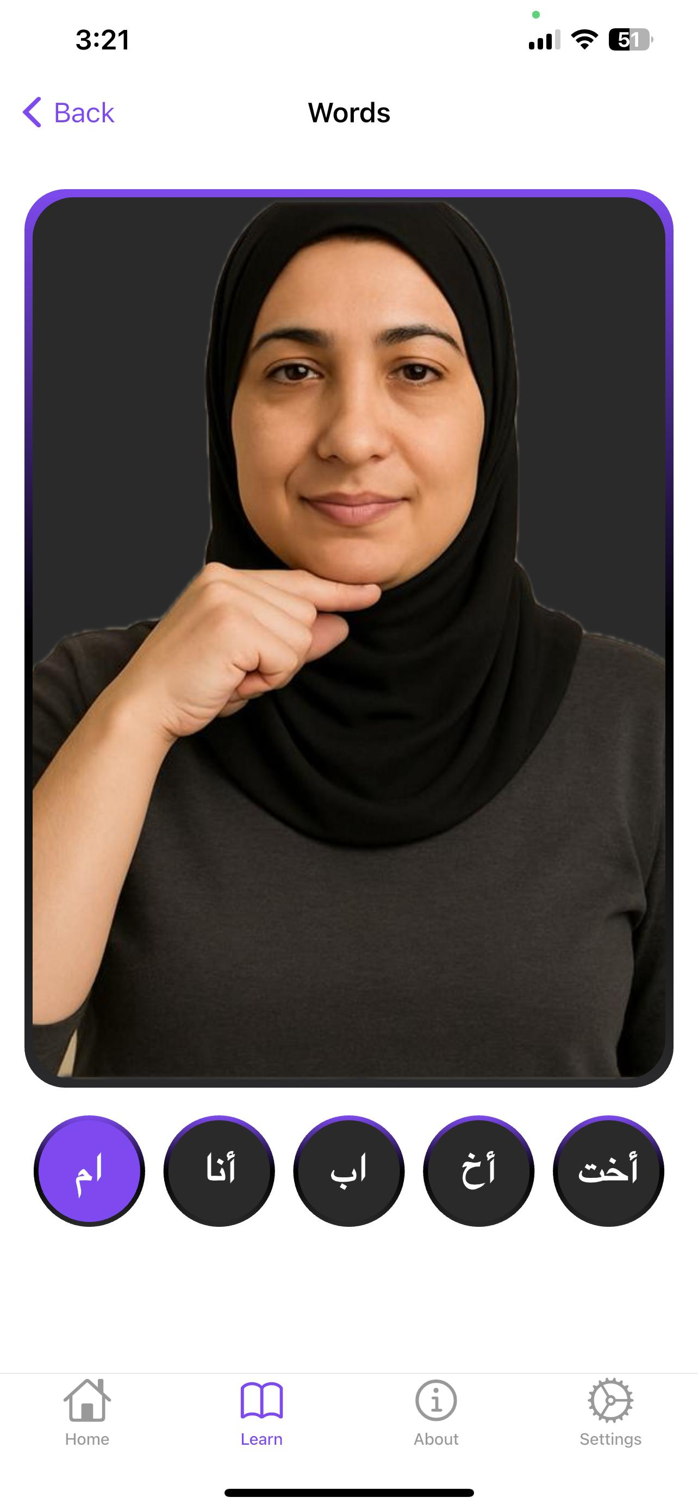

Slide 45
Technical Requirements and Tools
Programming Languages
Machine Learning Libraries
Image Processing Libraries
Python, JavaScript (for mobile applications).
TensorFlow or PyTorch for analyzing and interpreting hand gestures.
OpenCV for detecting and tracking hand movement.
Mobile App Development Platform
Data Management System
Development Environment
Firebase.
Visual Studio Code.
Flutter.

Slide 46
System components
Sign Language Recognition System
User Interface (UI)
AI Model
Database for Storage
Backend Server

Slide 47
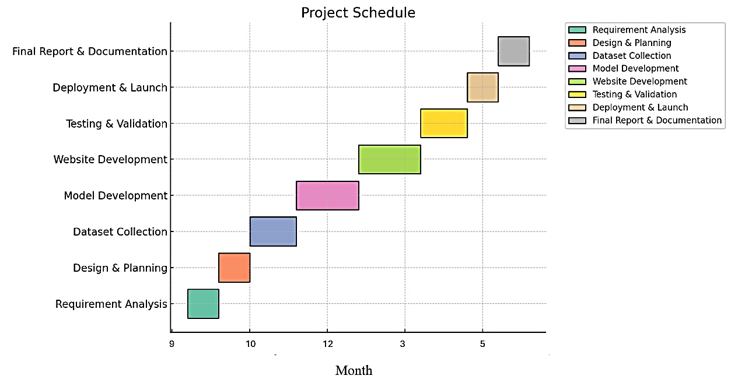
Timeline

Slide 48
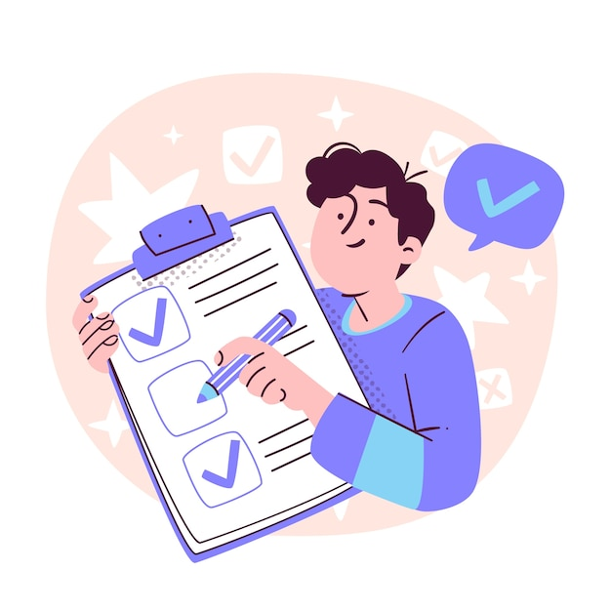
Conclusion
App for Converting Sign Language toWritten Text project
presents a promising solution for breaking down communication barriers and empowering the deaf and hard-of hearing community. Its innovative approach combining accurate recognition, Text-to-Speech conversion, and a user-friendly web app holds significant potential for fostering inclusivity and social interaction.

Slide 49
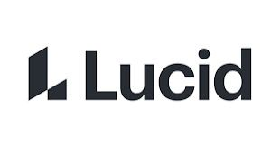

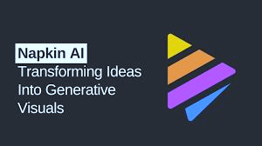


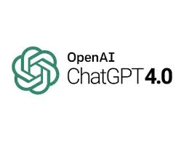
References
1.https://www.google.com/search?q=google+chrome&rlz=1C1GCEA_enEG1037EG1037&oq=google+cro&gs_lcrp=EgZjaHJvbWUqDAgBEAAYChixAxiABDIGCAAQRRg5MgwIARAAGAoYsQMYgAQyDwgCEAAYChiDARixAxiABDIJCAMQABgKGIAEMgkIBBAAGAoYgAQyBggFEEUYQDIJCAYQABgKGIAEMgkIBxAAGAoYgATSAQkxMjEyMmowajeoAgewAgE&sourceid=chrome&ie=UTF-8
2.https://www.google.com/search?sca_esv=833bfc8751d20ebd&rlz=1C1GCEA_enEG1037EG1037&sxsrf=ADLYWII9plwd5ASoJzSqJYI8Spr37CxbYQ:1733699540834&q=github&source=lnms&fbs=AEQNm0Aa4sjWe7Rqy32pFwRj0UkWd8nbOJfsBGGB5IQQO6L3JyJJclJuzBPl12qJyPx7ESJehObpS5jg6J88CCM-RK725uTmAZpGaaQNHAssOKTZzF03zpH3NSZ85lukZxfIrDeNjW1dKpNR73Zle-rWlJQvdXRgDsg9APD7N6ncYYkHf4gAZnk2noU2Ew8N32k9wesqK-da&sa=X&ved=2ahUKEwj7gJ2KppmKAxV-hf0HHXe6D-EQ0pQJegQIFBAB&biw=1435&bih=671&dpr=1.34
3.https://lucid.app/documents#/documents?folder_id=recent
4.https://www.youtube.com/
5https://www.napkin.ai/
6.https://chatgpt.com/

Slide 50


Thank you for
your support

